Slide 1
Introducing HTML5
Lesson 13 HTML5- Native Features

Slide 2

Lesson Objectives
In this lesson you will learn about:
List of HTML5 Native Features

Slide 3
List of HTML5 Native Features The Geolocation
The Geolocation API lets you find out where the user is.
It also keeps the track of as they move around, always with the user's consent
This functionality could be used as part of user queries, e.g. to guide someone to a destination point
It could also be used for "geo-tagging" some content the user has created, e.g. to mark where a photo was taken
The API is device-agnostic; it doesn't care how the browser determines location, so long as clients can request and receive location data in a standard way
The underlying mechanism might be via GPS, wifi, or simply asking the user to enter their location manually
Since any of these lookups is going to take some time, the API is asynchronous; you pass it a callback method whenever you request a location
Notes:
The Geolocation:
The Geolocation API provides a method to locate the user’s exact (more or less)
position. This is useful in a number of ways ranging from providing a user with
location specific information to providing route navigation.
Although it’s not actually part of the HTML5 specification, as it was developed as a
separate specification by the W3C, rather than the WHATWG.
The Geolocation API lets you find out where the user is and keep tabs on them as
they move around, always with the user's consent. This functionality could be used
as part of user queries, e.g. to guide someone to a destination point. It could also be
used for "geo-tagging" some content the user has created, e.g. to mark where a
photo was taken. The API is device-agnostic; it doesn't care how the browser
determines location, so long as clients can request and receive location data in a
standard way. The underlying mechanism might be via GPS, wifi, or simply asking
the user to enter their location manually. Since any of these lookups is going to take
some time, the API is asynchronous; you pass it a callback method whenever you
request a location.

Slide 4
List of HTML5 Native Features Browser Compatibility
Currently the W3C Geolocation API is supported by the following desktop browsers:
Firefox 3.5+
Chrome 5.0+
Safari 5.0+
Opera 10.60+
Internet Explorer 9.0+
There is also support for the W3C Geolocation API on mobile devices:
Android 2.0+
iPhone 3.0+
Opera Mobile 10.1+
Symbian (S60 3rd & 5th generation)
Blackberry OS 6

Slide 5
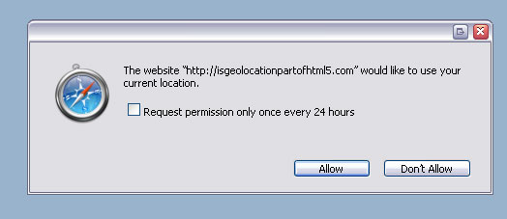
List of HTML5 Native Features Data Protection
The specification explicitly states that since the nature of the API also exposes the user’s location
Therefore it could compromise their privacy, the user’s permission to attempt to obtain the geolocation information must be sought before proceeding

Slide 6
List of HTML5 Native Features Geolocation - Steps to be followed
Step 1. Check for Compatibility
You can easily check for compatibility by testing for the presence of the geolocation object:
Step2. Determine the User's Current Location
// check for Geolocation support if (navigator.geolocation) { console.log('Geolocation is supported!'); } else { console.log('Geolocation is not supported for this Browser/OS version yet.'); }
window.onload = function() { var startPos; navigator.geolocation.getCurrentPosition(function(position) { startPos = position; document.getElementById('startLat').innerHTML = startPos.coords.latitude; document.getElementById('startLon').innerHTML = startPos.coords.longitude; }); };
Notes:
Determine the User's Current Location
getCurrentPosition() will asynchronously report on the user's current location.
Call it as soon as the page loads, so that it will correctly populate - and save for
later - the starting position:

Slide 7
List of HTML5 Native Features Geolocation - Steps to be followed
Step 3. Monitor the User's Location
window.onload = function() { var startPos; navigator.geolocation.getCurrentPosition(function(position) { startPos = position; document.getElementById('startLat').innerHTML = startPos.coords.latitude; document.getElementById('startLon').innerHTML = startPos.coords.longitude; }); };
Notes:
Monitor the User's Location
The previous call to getCurrentPosition() was only executed once, on page load. To
track changes, use watchPosition(). It will automatically notify a callback function
whenever the user moves:

Slide 8
DEMO
Geolocation\geolocation.jsp
Geolocation\geoLocationMap.html
Geolocation\getCurrentGeoLoc.html

Slide 9
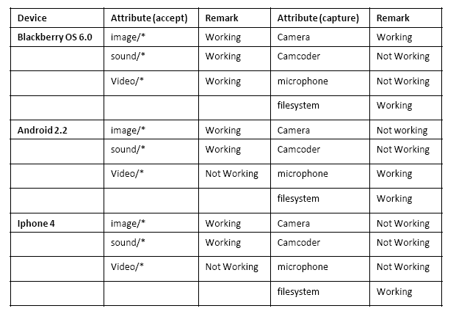
List of HTML5 Native Features HTML5 – Native Features
File System – File API used in directly accessing the internal file system of a device like memory card or phone memory and we can directly select any file from file system and upload to html5 page
<input type="file" accept="image/*;capture=filesystem" id="capture">
Notes:
File System
In html5 file system API we can directly access the internal file system of a device
like memory card or phone memory and we can directly select any file from file
system and upload to html5 page.
HTML5 and with the help of these API’s a user can directly access the file system of
devices like galley and phone memory etc.
In Native part we have different layer on a device on top we have Web packages
which bypass through java script extension and then access the gallery below policy
management.

Slide 10
Notes:
HTML5 syntax for using file-system API:
First we have to provide an input type in html tag like this-
<input type="file" accept="image/*;capture=filesystem" id="capture">
Where accept shows the file format acceptance extension if we use image then it
means that we can access the image directly from the device file system.
We can also use image/*, sound/*, or video/* mime types in accept attribute user
agent can invoke a file picker that allows respectively the user to take a picture,
record a sound file, or record a video in addition to selecting an existing file from
The file system. Similarly, the capture parameter can take one of the following values:
camera, camcorder, microphone, filesystem. These values indicate which source
the file picker interface should preferably present to the user by default. But we all
know that HTML5 is very new and its APIs are also in under development, That’s
why we can’t commit its behavior on each and every device, According to me I Am
tested this API’s on Blackberry 6.0, android 2.2 and iPhone 3.

Slide 11

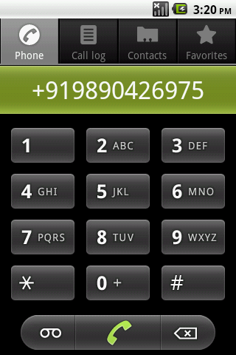
List of HTML5 Native Features HTML5 – Native Features
Call - In HTML5 we can call from HTML5 web page to any number using device internal calling Feature
<a href="tel:+918600993494" data-role="button" rel=”external”>Call Now</a>
Notes:
Call
In html5 we can call from html5 web page to any number using device internal
calling Feature this feature is same like XHTML because we can also use calling
feature using XHTML.
The html5 Telephonic API and with the help of telephonic API we can directly get
calling control of Device and call to any number.
HTML5 syntax for using call API:
<a href="tel:+918600993494" data-role="button" rel=external>Call Now</a>
We have to pass only contact number in href attribute. We have to pass only contact
number in href attribute.

Slide 12

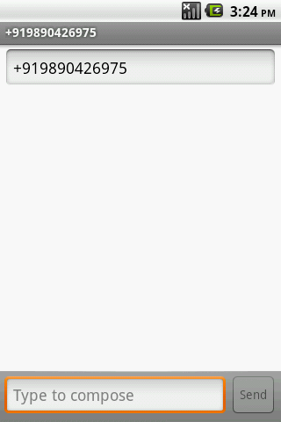
List of HTML5 Native Features HTML5 – Native Features
SMS - In html5 we can sms from html5 web page to any number using device internal sms feature
<a href="sms:+918600993494">Message me</a>
Notes:
SMS
In html5 we can SMS from HTML5 web page to any number using device internal
SMS Feature this feature is same like XHTML because we can also use SMS feature
using XHTML.
The html5 SMS API and with the help of SMS API we can directly get SMS window
control of Device and SMS to any number.
HTML5 syntax for using SMS API:
<a href="sms:+918600993494">Send information to me</a>
We have to pass only contact number in href attribute.

Slide 13
List of HTML5 Native Features HTML5 – Native Features
Email
HTML5 also provide support for Contact List & Camera but both the features are still in W3C Draft under Working
<a href=mailto:shilpa.bhosle@igatepatni.com>Write to Me</a>

Slide 14
DEMO
Nativ-API\makecall.html

Slide 15

Summary
In this module, you have learnt:
Different Native features supported by HTML5
Geolocation – Lets you find the user’s location and also monitors it
FileSystem – JavaScript API lets you access device’s internal memory card or phone memory
HTML5 also provides support for Call, Email & SMS native features

Slide 16

Review Question
State whether True/False
The Geolocation APIs are asynchronous APIs
Geolocation seeks the user's permission before obtaining their geographical presence
Fill in the blank
The ________ API used in directly accessing the internal file system of a device like memory card or phone memory
In HTML5 we can call from HTML5 web page to any number using _________ Feature

